Slide 1
An Investigation of
Machine Translation Evaluation Metrics in Cross-lingual Question Answering
Kyoshiro Sugiyama, Masahiro Mizukami, Graham Neubig,
Koichiro Yoshino, Sakriani Sakti, Tomoki Toda, Satoshi Nakamura
NAIST, Japan
Notes:
Thank you for the kind introduction.
Hello everyone, I’m Kyoshiro Sugiyama, a master student of NAIST in Japan.
In this presentation, I'd like to talk about translation quality with regards to cross-lingual question-answering tasks.
Our investigation makes clear what kind of evaluation metric is appropriate for question answering tasks, and what kind of mistranslations affect accuracy of question answering.

Slide 2

Question answering (QA)
One of the techniques for information retrieval
Input: Question ➔ Output: Answer
Information
Source
Retrieval
Where is the capital of Japan?
Retrieval Result
Tokyo.
Notes:
#イントロ少しだけ急ぐ
At first, I’d like to talk about the focus of our study, question-answering, QA.
QA is a type of information retrieval technique.
The input is a question sentence and the output is an answer to the input question.
For example, when I ask the system “Where is the capital of Japan?,”
anim. 1:
the system will retrieve the information from an information source,
anim. 2:
get a retrieval result and then output “Tokyo” according to the retrieval result.

Slide 3
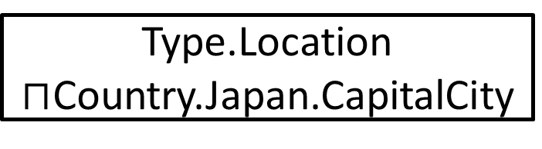
QA using knowledge bases
Convert question sentence into a query
Low ambiguity
Linguistic restriction of knowledge base
→ Cross-lingual QA is necessary
QA system using knowledge base
Where is the capital of Japan?
Type.Location
$⊓$Country.Japan.CapitalCity
Query
Knowledge base
Tokyo.
Location.City.Tokyo
Response
Notes:
#イントロ少しだけ急ぐ
Recently, there is much work on question answering systems using knowledge bases.
Such systems convert a question sentence into a logical expression for a knowledge base and reply with an answer using the response from the knowledge base.
By using knowledge bases, we can reduce ambiguity of the answers.
However, knowledge bases are only constructed for a few major languages, such as English.
Therefore, it often occurs / that it is necessary to perform cross-lingual QA.

Slide 4
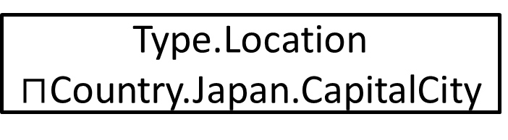
Cross-lingual QA (CLQA)
Question sentence ⬅(Linguistic difference)➔ Information source
To create mapping:
High cost and
not re-usable in other languages
QA system using knowledge base
日本の首都は
どこ？
Type.Location
$⊓$Country.Japan.CapitalCity
Query
Any language
Knowledge base
東京
Location.City.Tokyo
Response
Any language
Notes:
#イントロ少しだけ急ぐ
Cross-lingual QA, CLQA, is QA when the language of the question / differs / from the language of the information source.
anim. 1:
In CLQA using knowledge bases, it takes high cost to create a mapping from question sentence to query because data collection / and annotation by humans are necessary.
Also, we must perform these / in each language / that we want to use.

Slide 5
CLQA using machine translation
Machine translation (MT) can be used to perform CLQA
Easy, low cost and usable in many languages
QA accuracy depends on MT quality
Any language
Where is the capital of Japan?
Machine
Translation
Existing
QA system
日本の首都はどこ？
Any language
Machine
Translation
東京
Tokyo
Notes:
#イントロ少しだけ急ぐ
Machine translation is one reasonable answer for this problem.
If a question sentence is translated into the language of the information source, it is answerable by a mono-lingual QA system, and we can get an answer by re-translation from the system’s answer.
This way is easy to implement, low cost because it is possible to use existing systems, and usable in any languages which has linguistic resources.
And, it is clear that better translations improve QA accuracy.
However, existing MT systems are optimized for human consumption, and it is not clear whether an MT system that is better for human consumption is also better for CLQA.

Slide 6
Purpose of our work
To make clear how translation affects QA accuracy
  Which MT metrics are suitable for the CLQA task?
  → Creation of QA dataset using various translations systems
  → Evaluation of the translation quality and QA accuracy
  What kind of translation results influences QA accuracy?
  → Case study (manual analysis of the QA results)
Notes:
The purpose of our work is to make clear how translation affects QA accuracy, and to do so we performed experiments.
At first, we investigated the relationship between translation quality and QA accuracy.
We created data sets using various translation systems and performed question answering using existing QA systems.
Then, we manually analyzed in detail what kind of translation results cause changes of QA results.

Slide 7
QA system
SEMPRE framework [Berant et al., 13]
3 steps of query generation:
Alignment
  Convert entities in the question sentence
  into “logical forms”
Bridging
  Generate predicates compatible with
  neighboring predicates
Scoring
  Evaluate candidates using
  scoring function
Scoring
Notes:
In our experiments, we used the question answering framework of Berant et al., SEMPRE.
In this framework, the system answers in 3 steps.
anim. 1:
First, in the alignment step, the system converts entities in the question sentence into “logical forms,” such as “Type.University” or “BarackObama.”
anim. 2:
Second, in the bridging step, the system generates logical predicates compatible with neighboring predicates, and merges adjacent logical forms two by two, until only one logical form remains, and the remaining one becomes a query.
These two steps are not deterministic, so the system generates many candidates
anim. 3:
and in the scoring step, the system determines the best candidate according to the scoring function.
Training of the system is optimization of this scoring function.

Slide 8
Data set creation
HT set
Free917
Training
(512 pairs)
Translation
into English
GT set
Dev.
(129 pairs)
JA set
YT set
Test
(276 pairs)
(OR set)
Mo set
Manual translation
into Japanese
Tra set
Notes:
Next, I’d like to talk about how to create our data sets.
We used the Free917 data set as the original data set.
Free917 is a data set for question answering using Freebase, which is a structured large-scale knowledge base and open to the public for free.
It consists of 917 pairs of question sentence and correct query.
It is separated into three sets, training, development and test.
In this presentation, I call this original test set “the OR set.”
anim. 1:
For our experiments, we made translated test sets.
We manually translated each question sentence included in the OR set into Japanese.
I call this Japanese test set “the JA set.”
anim. 2:
And then we created translations of the JA set into English using five different methods.

Slide 9
Translation method
Manual Translation (“HT” set): Professional humans
Commercial MT systems
  Google Translate (“GT” set)
  Yahoo! Translate (“YT” set)
Moses (“Mo” set): Phrase-based MT system
Travatar (“Tra” set): Tree-to-String based MT system
Notes:
This slide shows the methods we used.
First, we asked a professional translation company to manually translate the questions from Japanese to English.
We call this manually translated set “the HT set”.
To create the GT and YT set, we used Google and Yahoo! translation engines.
Also, we used the phrase-based Moses toolkit and tree-to-string Travatar toolkit, to create the Mo and Tra set.

Slide 10
Experiments
Evaluation of translation quality of created data sets
  Reference is the questions in the OR set
QA accuracy evaluation using created data sets
  Using same model
➔ Investigation of correlation between them
Notes:
Now we have 6 test sets, the original set OR and 5 translated sets.
We evaluated their translation quality using various metrics.
In the evaluation, the reference is the OR set.
Also, using the created data sets, we performed question answering using SEMPRE.
The QA system is trained using the training and dev. sets of Free917.

Slide 11
Metrics for evaluation of translation quality
BLEU+1: Evaluates local n-grams
1-WER: Evaluates whole word order strictly
RIBES: Evaluates rank correlation of word order
NIST: Evaluates local word order and correctness of infrequent words
Acceptability: Human evaluation
Notes:
We used these 5 metrics in this slide.
BLEU+1 is a smoothed version of BLEU, which is / the most widely used metric / for measurement of machine translation quality.
Word error rate, WER, evaluates the edit distance / between reference and translation. It has the feature of evaluating word order / more strictly than BLEU. We used the value of 1-WER to adjust the axis direction so larger values are better.
RIBES is a metric based on rank correlation coefficient of word order in the translation and reference, and thus focuses on whether the translation / was able to achieve correct ordering.
NIST is a metric based on n-gram precision and each n-gram’s weight. Less frequent words are given more importance than more frequent words.
Finally, acceptability is a 5-grade manual evaluation metric. It combines aspects of both fluency and adequacy.

Slide 12
Translation quality
Notes:
This slide shows the result of translation quality evaluation.
anim. 1:
As you can see, the HT set, created by manual translation, has the highest quality on all metrics.
This indicates that manual translation is still more accurate than machines in this language pair and task.
#以下省いてもよいかも？
GT is the 2nd best on NIST and WER, while YT is higher than GT on acceptability and RIBES.
This confirms previous report that RIBES is well correlated with human judgments of acceptability for Japanese-English translation tasks.

Slide 13
QA accuracy
Notes:
Next, this graph shows question answering accuracy of each data set.
I’ll talk about a few interesting points in the next few slides.

Slide 14
Translation quality and QA accuracy
Notes:
We can see that YT has lower accuracy than GT, although it’s the best MT system for acceptability.
This result indicates that translation which is good for CLQA is clearly different from translation which are good for humans.

Slide 15
Translation quality and QA accuracy
Notes:
On the other hand, GT has the highest QA accuracy.
anim. 2:
It is expressed with NIST score well.
Also, the shapes of these two graphs are very similar, so probably there is a high correlation between NIST score and QA accuracy.

Slide 16
Sentence-level analysis
47% questions of OR set are not answered correctly
→ These questions might be difficult to answer
even with the correct translation result
Dividing questions into two groups
  Correct group (141*5=705 questions):
  Translated from 141 questions answered correctly in OR set
  Incorrect group (123*5=615 questions):
  Translated from remaining 123 questions in OR set
Notes:
Next, we performed a sentence-level analysis of QA results.
First, we note that about 47% of questions in the OR set couldn’t be answered correctly.
These questions might be difficult to answer even with the correct translation,
so we divided all translated questions into 2 groups.
One is the “correct” group.
This group consists of questions that were answered correctly in the OR set.
In the OR set, the 141 questions were answered correctly, so the correct group has 705 questions.
The other group is the “incorrect” group.
This group consists of the remaining questions in the OR set.
123 questions were not answered correctly, so the incorrect group has 615 questions.

Slide 17
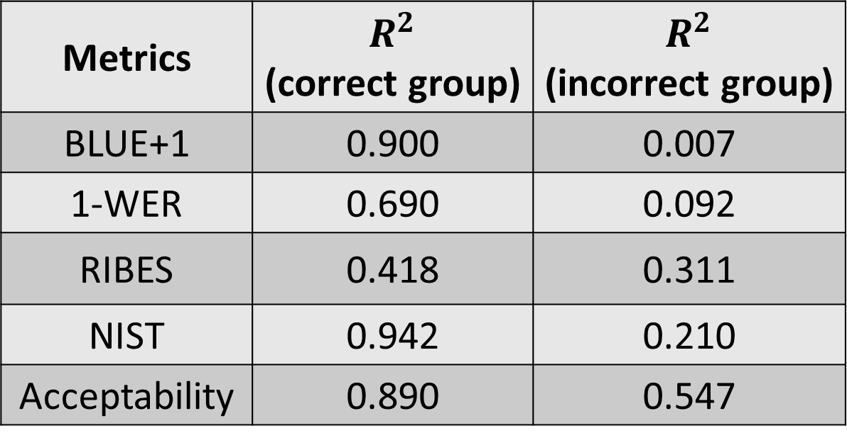
Sentence-level correlation
Metrics | $R^{2}$ (correct group) | $$R^{2}$$ (incorrect group)
BLUE+1 | 0.900 | 0.007
1-WER | 0.690 | 0.092
RIBES | 0.418 | 0.311
NIST | 0.942 | 0.210
Acceptability | 0.890 | 0.547
Notes:
This table shows the sentence-level correlation between question answering accuracy and evaluation score of each group and metric.

Slide 18
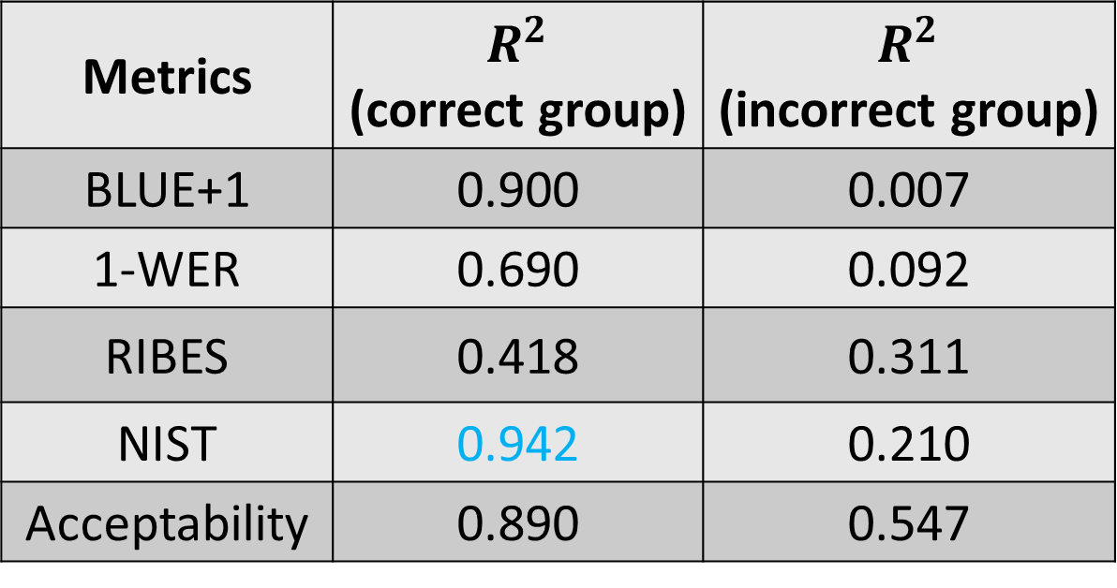
Sentence-level correlation
Metrics | $R^{2}$ (correct group) | $$R^{2}$$ (incorrect group)
BLUE+1 | 0.900 | 0.007
1-WER | 0.690 | 0.092
RIBES | 0.418 | 0.311
NIST | 0.942 | 0.210
Acceptability | 0.890 | 0.547
Very little correlation
NIST has the highest correlation
➔ Importance of content words
If the reference cannot be answered correctly, the sentences are not suitable,
even for negative samples
Notes:
As you can see, the NIST metric has the highest correlation in the correct group.
This indicates the importance of content words, which are scored more heavily by NIST’s frequency weighting.
anim. 1:
Also you can see, all metrics except acceptability have a very little correlation in the incorrect group.
anim. 2:
This indicates that if the reference cannot be answered correctly, the sentences are not suitable to optimize an MT system, even for negative samples.

Slide 19
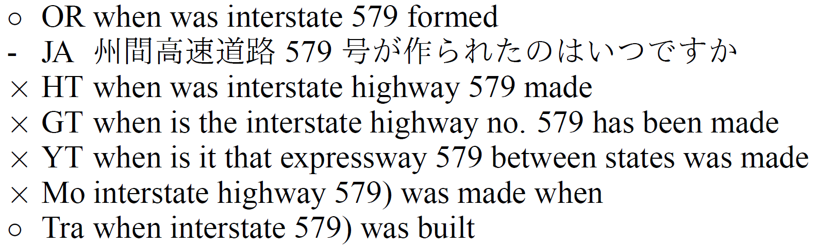




Sample 1
Notes:
Next, I’d like to show you some examples of question answering results.
In the first sample, the phrase “interstate 579” has been translated in various ways.
anim. 1:
Only OR and Tra have the phrase “interstate 579” and have been answered correctly.
The output logical form of other translations lack the entity of highway “interstate 579”, mistaking it for another entity.
anim. 2:
For example, the phrase “interstate highway 579” is instead aligned to the entity of the music album “interstate highway.”
Likewise in GT, the phrase “has been” is aligned to the music album “has been,” and in Mo, “highway 579” is aligned to another highway.
This is indicating that the change of content words to the point that they don’t match entities in the entity lexicon is a very important problem.
To ameliorate this problem, it may be possible to modify the translation system to consider the named entity lexicon as a feature in the translation process.

Slide 20
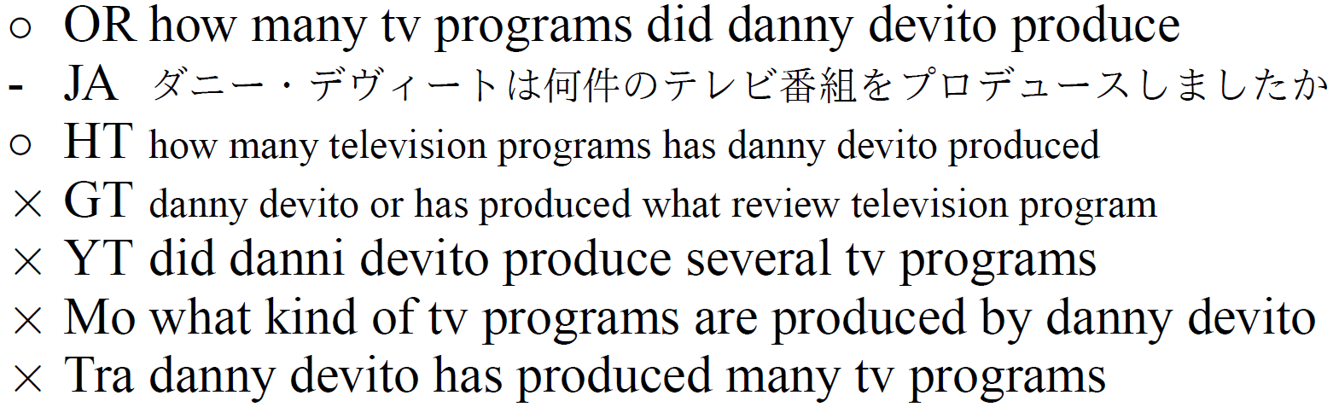
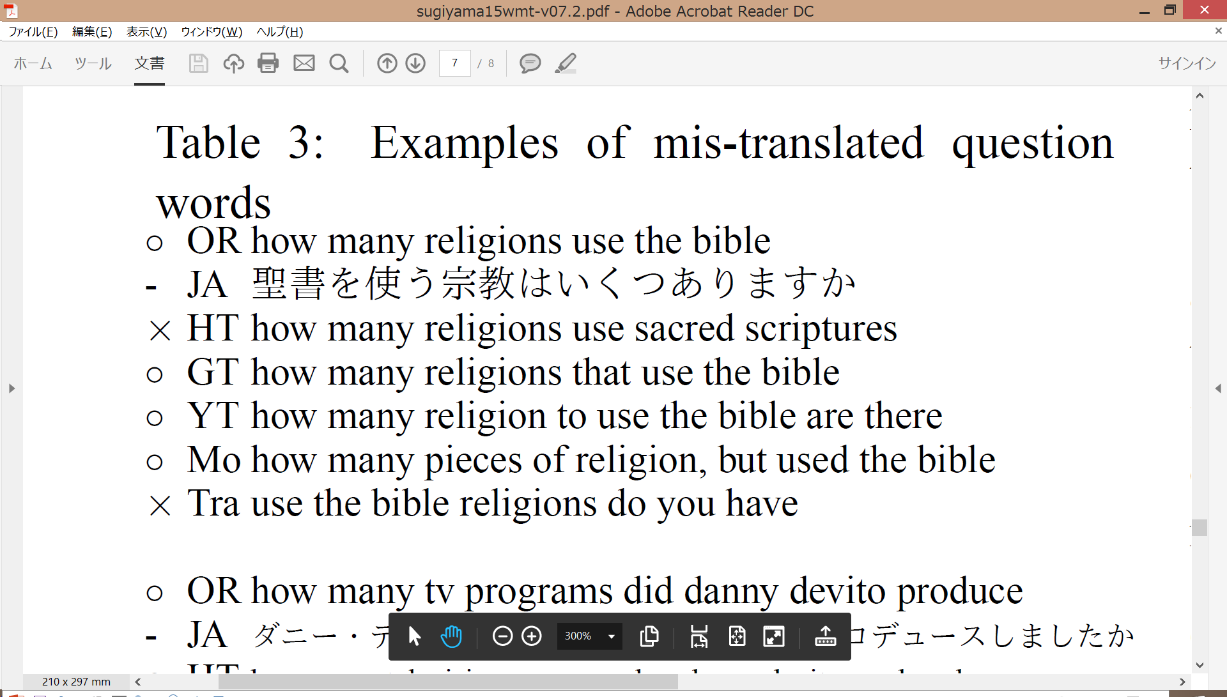
Sample 2
Lack of the
question type-word
Notes:
In the second example, the translations which have all of the content words are answered incorrectly.
The common point of these questions is lack of the question type-word, such as “how many.”
These words are frequent, so even NIST score will not be able to perform adequate evaluation, indicating that other measures may be necessary.

Slide 21
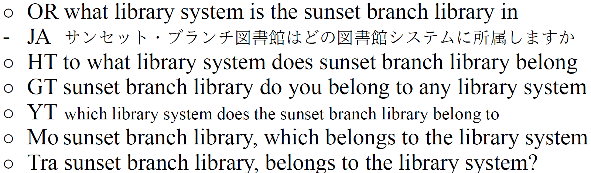
Sample 3
All questions were answered correctly
though they are grammatically incorrect.
Notes:
In the third example, all questions are answered correctly, though they are grammatically incorrect.
This example indicates that, at least for the relatively simple questions in Free917, achieving correct word ordering plays only a secondary role in achieving high QA accuracy.

Slide 22
Conclusion
NIST score has the highest correlation
  NIST is sensitive to the change of content words
If reference cannot be answered correctly,
there is very little correlation
between translation quality and QA accuracy
➔Answerable references should be used
3 factors which cause change of QA results:
content words, question types and syntax
Notes:
This is our conclusion, thank you very much.
-------------------------If I have a time--------------------------
This is the conclusion of our presentation.
First, NIST score, which is sensitive to the change of content words, has the highest correlation with question answering accuracy.
This indicates importance of content words.
Therefore, in cross-lingual question answering tasks, we recommend to use NIST or other metrics putting a weight on content words.
Second, if references cannot be answered correctly, there is very little correlation between translation quality and QA accuracy.
So, references that are actually answerable by the QA system should be used.
Finally, we identified the 3 factors which cause change of QA results: content words, question type-words and syntax.
That’s all, thank you for listening.

Slide 23
Sentence-level correlation: BLEU+1

Slide 24
Sentence-level correlation: 1-WER

Slide 25
Sentence-level correlation: RIBES

Slide 26
Sentence-level correlation: NIST

Slide 27
Sentence-level correlation: Acceptability

Slide 28
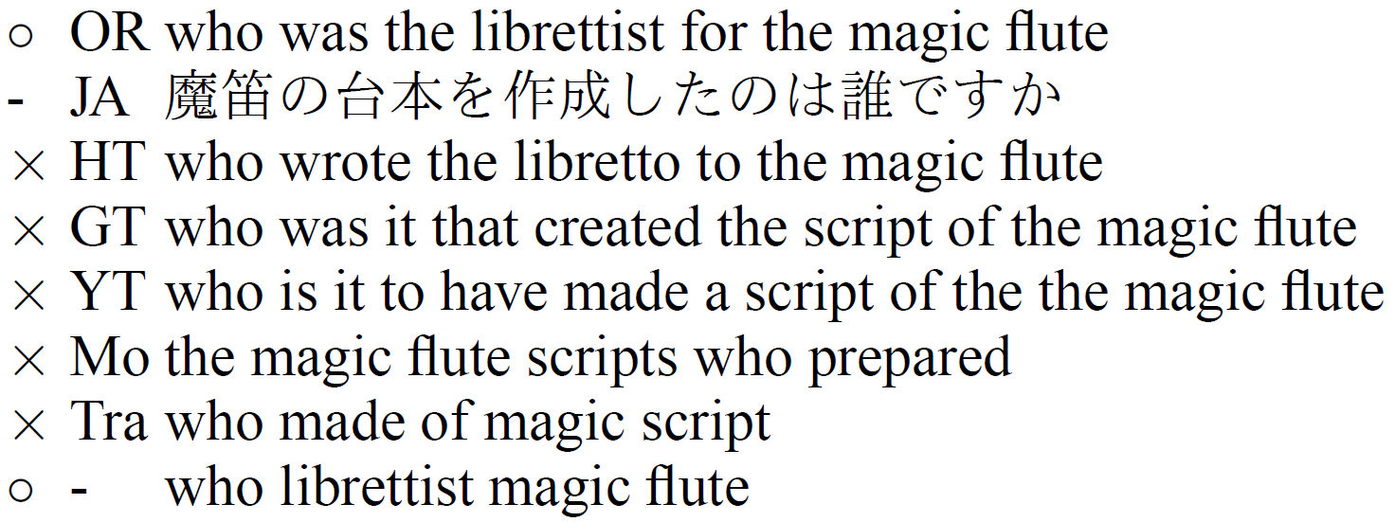
Sample 2

Slide 29
Sample 4

Slide 30
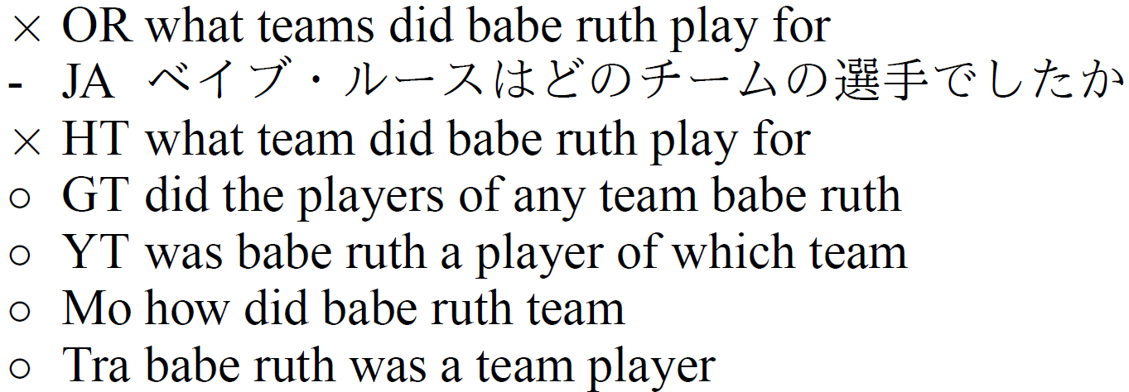
Sample 4
They were wrong answered
though they are grammatically correct
Correct grammar is
not so important
Notes:
On the other hand, in the 4th example, OR and HT are grammatically correct but were answered incorrectly.

