Slide 1
Automatic Post-editing (pilot) Task
Rajen Chatterjee, Matteo Negri and Marco Turchi
Fondazione Bruno Kessler
[ chatterjee | negri | turchi ]@fbk.eu
Notes:
Max 20 MINUTI!!!

Slide 2
Automatic post-editing pilot @ WMT15
Task
  Automatically correct errors in a machine-translated text
Impact
  Cope with systematic errors of an MT system whose decoding process is not accessible
  Provide professional translators with improved MT output quality to reduce (human) post-editing effort
  Adapt the output of a general-purpose MT system to the lexicon/style requested in specific domains
Notes:
Improve MT output by exploiting information unavailable to the decoder, or by performing deeper text analysis that is too expensive at the decoding stage;
Cope with systematic errors of an MT system whose decoding process is not accessible;
Provide professional translators with im- proved MT output quality to reduce (human) post-editing effort;
Adapt the output of a general-purpose MT system to the lexicon/style requested in a spe- cific application domain.

Slide 3

Automatic post-editing pilot @ WMT15
Task
  Automatically correct errors in a machine-translated text
Impact
  Cope with systematic errors of an MT system whose decoding process is not accessible
  Provide professional translators with improved MT output quality to reduce (human) post-editing effort
  Adapt the output of a general-purpose MT system to the lexicon/style requested in specific domains
Notes:
BLACK BOX conditions!

Slide 4
Automatic post-editing pilot @ WMT15
Objectives of the pilot
  Define a sound evaluation framework for future rounds
  Identify critical aspects of data acquisition and system evaluation
  Make an inventory of current approaches and evaluate the state of the art

Slide 5

Evaluation setting: data
Data (provided by
  English-Spanish, news domain
Training: 11,272 (src, tgt, pe) triplets
  src: tokenized EN sentence
  tgt: tokenized ES translation by an unknown MT system
  pe: crowdsourced human post-edition of tgt
Development: 1,000 triplets
Test: 1,817 (src, tgt) pairs
)
Notes:
https://unbabel.com/

Slide 6
Evaluation setting: data
Data (provided by
  English-Spanish, news domain
Training: 11,272 (src, tgt, pe) triplets
  src: tokenized EN sentence
  tgt: tokenized ES translation by an unknown MT system
  pe: crowdsourced human post-edition of tgt
Development: 1,000 triplets
Test: 1,817 (src, tgt) pairs
)
Notes:
https://unbabel.com/

Slide 7
Evaluation setting: metric and baseline
Metric
  Average TER between automatic and human post-edits (the lower the better)
  Two modes: case sensitive/insensitive
Baseline(s)
  Official: average TER between tgt and human post-edits (a system that leaves the tgt test instances unmodified)
  Additional: a re-implementation of the statistical post-editing method of Simard et al. (2007)
    “Monolingual translation”: phrase-based Moses system trained with (tgt, pe) “parallel” data

Slide 8
Evaluation setting: metric and baseline
Metric
  Average TER between automatic and human post-edits (the lower the better)
  Two modes: case sensitive/insensitive
Baseline(s)
  Official: average TER between tgt and human post-edits (a system that leaves the tgt test instances unmodified)
  Additional: a re-implementation of the statistical post-editing method of Simard et al. (2007)
    “Monolingual translation”: phrase-based Moses system trained with (tgt, pe) “parallel” data

Slide 9
Participants and results

Slide 10
Participants (4) and submitted runs (7)
Abu-MaTran (2 runs)
  Statistical post-editing, Moses-based
  QE classifiers to chose between MT and APE
    SVM-based HTER predictor
    RNN-based to label each word as good or bad
FBK (2 runs)
  Statistical post-editing:
    The basic method of (Simard et al. 2007): f’ ||| f
    The “context-aware” variant of (Béchara et al. 2011): f’#e ||| f
    Phrase table pruning based on rules’ usefulness
    Dense features capturing rules’ reliability
Notes:
Abu-MaTran project (2 runs)
Statistical post-editing, Moses-based
Trained with external data (News Commentary)
Sentence-level classifiers to chose between MT and APE output
SVM-based HTER predictor
RNN-based to label each word as good or bad
FBK
PT PRUNING WITH NEG-IMPACT
For each translation option in the phrase table, all the parallel sentences are retrieved from the training set such that the source phrase of the translation option is present in the source sentence of the parallel corpus. We then substitute the target phrase of the translation option in the source sentence of the parallel corpus and then compute the TER score wrt. the corresponding target sentence. If TER increases then we increment the neg-count by 1, and if TER decreases we increment the pos-count by 1.
DENSE FEATURES
Similarity (f1): similarity between the source and target phrase of the translation options.
Reliability (f2.1 and f2.2) :statistics of the quality (in terms of HTER) of the parallel sentences used to learn that particular translation option. Better the quality, higher the likelihood to learn reliable rules.
- pos-impact: to measure the positive impact of a translation option over the training set. Higher the positive impact, higher is its usefulness.

Slide 11
Participants (4) and submitted runs (7)
LIMSI (2 runs)
  Statistical post-editing
  Sieves-based approach
    PE rules for casing, punctuation and verbal endings
USAAR (1 run)
  Statistical post-editing
  Hybrid word alignment combining multiple aligners
Notes:
Preprocessing: stemming of MT output and PE

Slide 12
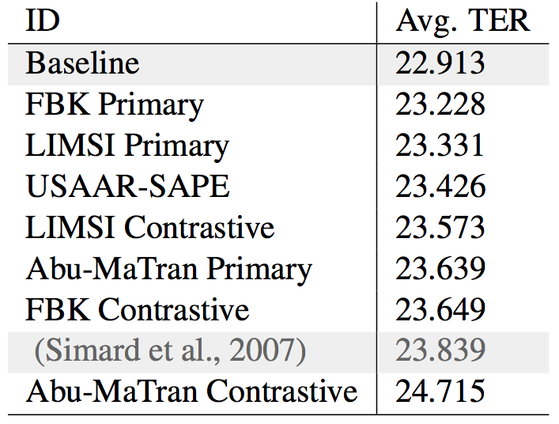
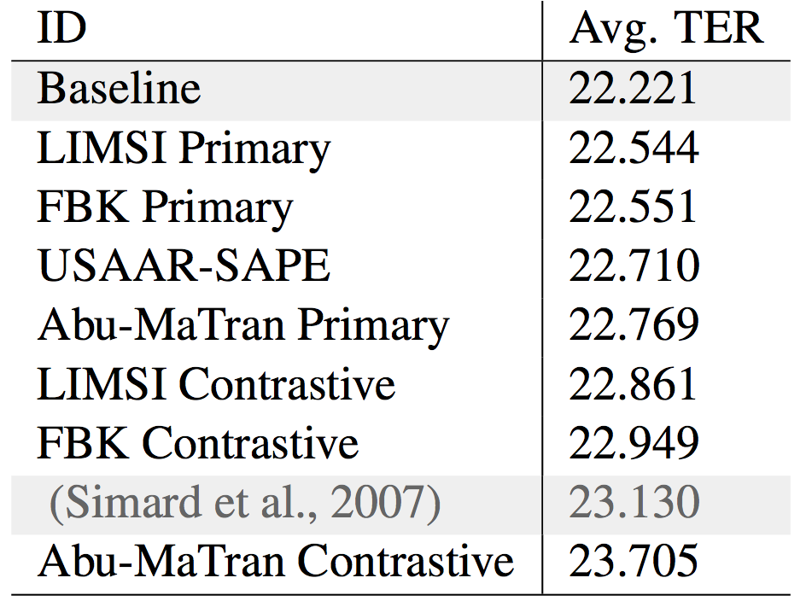
Results (Average TER ⬇)
Case sensitive
Case insensitive

Slide 13
Results (Average TER ⬇)
Case sensitive
Case insensitive
None of the submitted runs improved over the baseline
Similar performance difference between case sensitive/insensitive
Close results reflect the same underlying statistical APE approach
Improvements over the common backbone indicate some progress
Notes:
(differences are statistically significant)…
In practice, this means that what the systems learned from the available data was not reliable enough to yield valid corrections of the test instances.

Slide 14
Results (Average TER ⬇)
Case sensitive
Case insensitive
None of the submitted runs improved over the baseline
Similar performance difference between case sensitive/insensitive
Close results reflect the same underlying statistical APE approach
Improvements over the common backbone indicate some progress
Notes:
About 0.7 TER DIFFERENCE!!!!
Similar performance drops with case sensitive evaluation across participants
Case sensitive evaluation does not penalize specific systems

Slide 15
Results (Average TER ⬇)
Case sensitive
Case insensitive
None of the submitted runs improved over the baseline
Similar performance difference between case sensitive/insensitive
Close results reflect the same underlying statistical APE approach
Improvements over the common backbone indicate some progress

Slide 16
Results (Average TER ⬇)
Case sensitive
Case insensitive
None of the submitted runs improved over the baseline
Similar performance difference between case sensitive/insensitive
Close results reflect the same underlying statistical APE approach
Improvements over the common backbone indicate some progress
Notes:
Statistically significant improvements over the re-implemented statistical APE (prior reference technique ) indicate some progress

Slide 17
Discussion

Slide 18
Discussion: the role of data
Experiments with the Autodesk Post-Editing Data corpus
  Same languages (EN-ES)
  Same amount of target words for training, dev and test
  Same data quality (~ same TER)
  Different domain: software manuals (vs news)
  Different origin: professional translators (vs crowd)
 |  | APE Task data | Autodesk data
Type/Token Ratio | SRC | 0.1 | 0.05
 | TGT | 0.1 | 0.45
 | PE | 0.1 | 0.05
Repetition Rate | SRC | 2.9 | 6.3
 | TGT | 3.3 | 8.4
 | PE | 3.1 | 8.5
Notes:
The impact of quantity, sparsity, domain, origin of the data
In this setting, performance differences between systems trained on the two datasets will only depend on the different nature of the data (e.g. domain).
TTR is the ratio obtained by dividing the types (the total number of different words) occurring in a text or utterance by its tokens (the total number of words).
A high TTR indicates a high degree of lexical variation while a low TTR indicates the opposite
Type/Token Ratio (DOWNARROW)
Repetition Rate (UPARROW)
TTR:
APE Task
0,099053853 (23,608 / 238,335)
0,097503134 (25,121 / 257,643)
0,10509192 (27,101 / 257,879)
Autodesk
0,053736105 (11,858 / 220,671)
0,045539669 (11,721 / 257,380)
0,047629108 (12,399 / 260,324)

Slide 19
Discussion: the role of data
Experiments with the Autodesk Post-Editing Data corpus
  Same languages (EN-ES)
  Same amount of target words for training, dev and test
  Same data quality (~ same TER)
  Different domain: software manuals (vs news)
  Different origin: professional translators (vs crowd)
 |  | APE Task data | Autodesk data
Type/Token Ratio | SRC | 0.1 | 0.05
 | TGT | 0.1 | 0.45
 | PE | 0.1 | 0.05
Repetition Rate | SRC | 2.9 | 6.3
 | TGT | 3.3 | 8.4
 | PE | 3.1 | 8.5
More repetitive
Easier?
Notes:
Repetition rate (Bertoldi et al., 2013---MT SUMMIT 2013) as a way to measure the repetitiveness inside a text, by looking at the rate of non-singleton n-gram types (n=1. . .4) it contains.
The impact of quantity, sparsity, domain, origin of the data
In this setting, performance differences between systems trained on the two datasets will only depend on the different nature of the data (e.g. domain).
TTR is the ratio obtained by dividing the types (the total number of different words) occurring in a text or utterance by its tokens (the total number of words).
A high TTR indicates a high degree of lexical variation while a low TTR indicates the opposite
Type/Token Ratio (DOWNARROW)
Repetition Rate (UPARROW)
TTR:
APE Task
0,099053853 (23,608 / 238,335)
0,097503134 (25,121 / 257,643)
0,10509192 (27,101 / 257,879)
Autodesk
0,053736105 (11,858 / 220,671)
0,045539669 (11,721 / 257,380)
0,047629108 (12,399 / 260,324)

Slide 20
Discussion: the role of data
Repetitiveness of the learned correction patterns
  Train two basic statistical APE systems
  Count how often a translation option is found in the training pairs (more singletons = higher sparseness)
 | Percentage of phrase pairs
Phrase pair count | APE task data | Autodesk data
1 | 95.2 | 84.6
2 | 2.5 | 8.8
3 | 0.7 | 2.7
4 | 0.3 | 1.2
5 | 0.2 | 0.6
Total entries | 1,066,344 | 703,944
Notes:
The impact of quantity, sparsity, domain, origin of the data
We consider the distribution of the frequency of the translation options in the phrase table as a good indicator of the level of repetitiveness of the corrections in the data.
For instance, a large number of translation options that appear just one or only few times in the data indicates a higher level of sparseness.
As expected due to the limited size of the training set, the vast majority of the translation options in both phrase tables are singletons.
Nevertheless, the Autodesk phrase table is more compact (731k versus 1,066k) and contains 10% fewer singletons than the APE task phrase table.

Slide 21
Discussion: the role of data
Repetitiveness of the learned correction patterns
  Train two basic statistical APE systems
  Count how often a translation option is found in the training pairs (more singletons = higher sparsity)
 | Percentage of phrase pairs
Phrase pair count | APE task data | Autodesk data
1 | 95.2 | 84.6
2 | 2.5 | 8.8
3 | 0.7 | 2.7
4 | 0.3 | 1.2
5 | 0.2 | 0.6
Total entries | 1,066,344 | 703,944
Less singletons
Repeated translation
options
More compact PT
Easier?

Slide 22
Discussion: professional vs. crowdsourced PEs
Professionals translators
  Necessary corrections to maximize productivity
  Consistent translation/correction criteria
Crowdsourced workers
  No specific time/consistency constraints
Analysis of 221 test instances post-edited by professional translators
MT output
TER: 23.85
TER: 26.02
Professional PEs
Crowdsourced PEs
TER: 29.18
Notes:
Professionals translators:
Necessary and sufficient corrections to maximize productivity
Follow consistent translation/correction criteria, esp. for domain terms
Result: coherent and minimally post-edited data
Crowdsourced workers
No specific time/consistency constraints
Result: less coherence, higher noise, higher sparsity?
Analysis of 221 WMT test instances randomly sampled

Slide 23
Discussion: professional vs. crowdsourced PEs
Professionals translators
  Necessary corrections to maximize productivity
  Consistent translation/correction criteria
Crowdsourced workers
  No specific time/consistency constraints
Analysis of 221 test instances post-edited by professional translators
The crowd corrects more
MT output
TER: 23.85
TER: 26.02
Professional PEs
Crowdsourced PEs
TER: 29.18

Slide 24
Discussion: professional vs. crowdsourced PEs
Professionals translators
  Necessary corrections to maximize productivity
  Consistent translation/correction criteria
Crowdsourced workers
  No specific time/consistency constraints
Analysis of 221 test instances post-edited by professional translators
The crowd corrects more
MT output
The crowd corrects differently
TER: 23.85
TER: 26.02
Professional PEs
Crowdsourced PEs
TER: 29.18

Slide 25
Discussion: impact on performance
Evaluation on the respective test sets
 | Avg. TER
 | APE task data | Autodesk data
Baseline | 22.91 | 23.57
(Simard et al. 2007) | 23.83 (+0.92) | 20.02 (-3.55)
More difficult task with WMT data
  Same baseline but significant TER differences
  -1.43 points with 25% of the Autodesk training instances
Repetitiveness and homogeneity help!
Notes:
NOTE:
Baseline results are very close, due to the fact MT quality is similar on APE task and Autodesk data.
Simard, however, does much better on Autodesk!!!
Even with less data!!

Slide 26
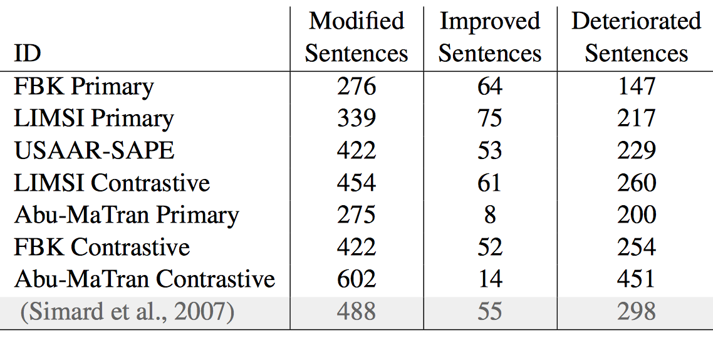
Discussion: systems’ behavior
Few modified sentences (22% on average)
Best results achieved by conservative runs
  A consequence of data sparsity?
  An evaluation problem: good corrections can harm TER
  A problem of statistical APE: correct words should not be touched
Notes:
NOTE THAT:
… TER is a distance measure computed against human “references”; good corrections can increase the distance!
… APE is not MT! In MT all the input source words have to be translated, while in APE the correct words should be left untouched!

Slide 27
Summary
Define a sound evaluation framework
  No need of radical changes in future rounds
Identify critical aspects for data acquisition
  Domain: specific vs general
  Post-editors: professional translators vs crowd
Evaluate the state of the art
  Same underlying approach
  Some progress due to slight variations
    But the baseline is unbeaten
  Problem: how to avoid unnecessary corrections?
Notes:
The next round is in preparation
A new language pair EN-DE (translation into more difficult language)?
Case sensitive evaluation only
Domain-specific data?
From professional translators?

Slide 28
Summary
✔
Define a sound evaluation framework
  No need of radical changes in future rounds
Identify critical aspects for data acquisition
  Domain: specific vs general
  Post-editors: professional translators vs crowd
Evaluate the state of the art
  Same underlying approach
  Some progress due to slight variations
    But the baseline is unbeaten
  Problem: how to avoid unnecessary corrections?
Notes:
The next round is in preparation
A new language pair EN-DE (translation into more difficult language)?
Case sensitive evaluation only
Domain-specific data?
From professional translators?

Slide 29
Summary
✔
Define a sound evaluation framework
  No need of radical changes in future rounds
Identify critical aspects for data acquisition
  Domain: specific vs general
  Post-editors: professional translators vs crowd
Evaluate the state of the art
  Same underlying approach
  Some progress due to slight variations
    But the baseline is unbeaten
  Problem: how to avoid unnecessary corrections?
☹
Notes:
The next round is in preparation
A new language pair EN-DE (translation into more difficult language)?
Case sensitive evaluation only
Domain-specific data?
From professional translators?

Slide 30
Summary
✔
Define a sound evaluation framework
  No need of radical changes in future rounds
Identify critical aspects for data acquisition
  Domain: specific vs general
  Post-editors: professional translators vs crowd
✔
Notes:
The next round is in preparation
A new language pair EN-DE (translation into more difficult language)?
Case sensitive evaluation only
Domain-specific data?
From professional translators?

Slide 31
Summary
✔
Define a sound evaluation framework
  No need of radical changes in future rounds
Identify critical aspects for data acquisition
  Domain: specific vs general
  Post-editors: professional translators vs crowd
Evaluate the state of the art
  Same underlying approach
  Some progress due to slight variations
    But the baseline is unbeaten
  Problem: how to avoid unnecessary corrections?
✔
Notes:
The next round is in preparation
A new language pair EN-DE (translation into more difficult language)?
Case sensitive evaluation only
Domain-specific data?
From professional translators?

Slide 32
Summary
✔
Define a sound evaluation framework
  No need of radical changes in future rounds
Identify critical aspects for data acquisition
  Domain: specific vs general
  Post-editors: professional translators vs crowd
Evaluate the state of the art
  Same underlying approach
  Some progress due to slight variations
    But the baseline is unbeaten
  Problem: how to avoid unnecessary corrections?
✔
✔
Notes:
The next round is in preparation
A new language pair EN-DE (translation into more difficult language)?
Case sensitive evaluation only
Domain-specific data?
From professional translators?

Slide 33
Thanks!
Questions?

Slide 35
The “aggressiveness” problem
MT: translation of the entire source sentence
  Translate everything!
SAPE: “translation” of the errors
  Don’t correct everything! Mimic the human!
SRC: 巴尔干的另一个关键步骤
TGT: Yet a key step in the Balkans
TGT_corrected: Another key step for the Balkans

Slide 36
The “aggressiveness” problem
MT: translation of the entire source sentence
  Translate everything!
SAPE: “translation” of the errors
  Don’t correct everything! Mimic the human!
SRC: 巴尔干的另一个关键步骤
TGT: Yet a key step in the Balkans
TGT_corrected: Another key step for the Balkans

Slide 37
The “aggressiveness” problem
MT: translation of the entire source sentence
  Translate everything!
SAPE: “translation” of the errors
  Don’t correct everything! Mimic the human!
SRC: 巴尔干的另一个关键步骤
Changing correct terms will be penalized by TER-based evaluation against humans
TGT: Yet a key step in the Balkans
TGT_corrected: Another crucial step for the Balkans

